Slide 1

mortality rate by state from most common diseases in 2020-2022
Project 1 Group 4
Made By Bethelhem , Umeadi , Joshua , Maksym

Slide 2
Introduction
Our project focuses on the death rate by state in the United States . We used data from the CDC to further break down the mortality rate from diseases such as COVID-19, Heart Disease, Alzheimer’s, Cancer, Influenza and more. This project is important because it highlights the states that are most affected by these illnesses and the seasons of the year that receive the largest number of deaths. We break the data down and comb through each year to fully analyze the data and compare the mortality rate of different diseases throughout the years 2020-2022.

Slide 3
Questions we tried to answer:
Which state has reported the highest number of deaths in the last 3 years?
Which are the top 10 states with highest number of deaths?
What are the main causes of death in US?
In what season do most deaths occur by natural causes and what is the correlation between the seasons where the most deaths occur by all causes and natural causes?
In what season is the death rate highest due to Cancer & Septicemia?
In what season is the death rate highest due to Influenza & Respiratory Diseases?
Does COVID-19 have any impact on the death totals and rates for the other mortality measures?
In what season is the death rate highest due to COVID-19 and heart disease?

Slide 4
Data cleaning and preparation
Imported data files and read the data using pd.read_csv(death_data_path)
Obtained a list of columns for death_data and population_data then reduced the number of columns to only show 2020-2022
Filtered the data to only show the diseases were wanted to further analyze
Changed the data type from object to datetime and added month, year and month-year columns.
Extracted month by the month names.
Created a season list by month.
Renamed the columns so it’s easier to read & understand.
Combined Cerebrovascular diseases and heart diseases into one column named “all heart diseases”.
Combined columns for chronic lower respiratory diseases and other diseases in the respiratory system into one column named “respiratory diseases”.
Reordered columns for visibility and so data is able to be understood easily.
Identified incomplete rows and filled the NAs with 0 and replaced the NaN values with 0
Verified all row counts so they are equal to 8,164
Converted measured to an integer data type
Organized the data so it shows the deaths by year and month
Created a population by year and state data frames

Slide 5
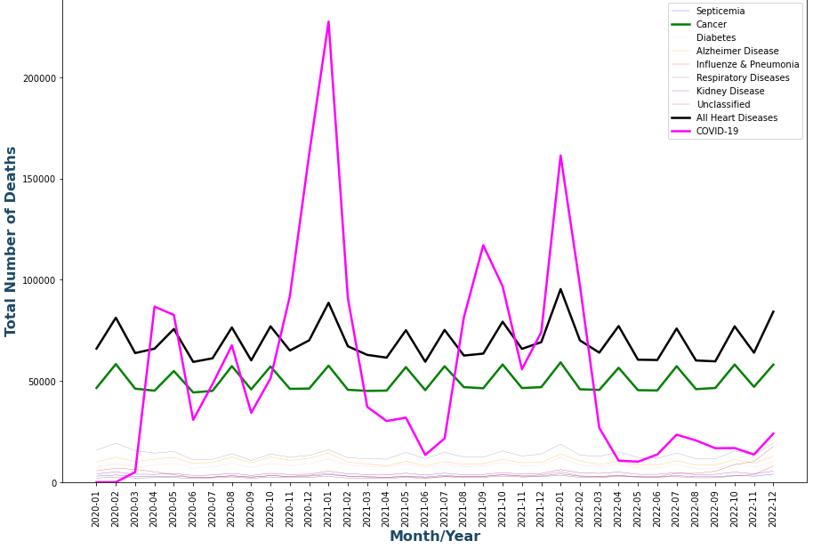
What are the main causes of death in the United States? Through our data we learn that COVID 19, heart disease and cancer are the main causes of death in the United States.

Slide 6
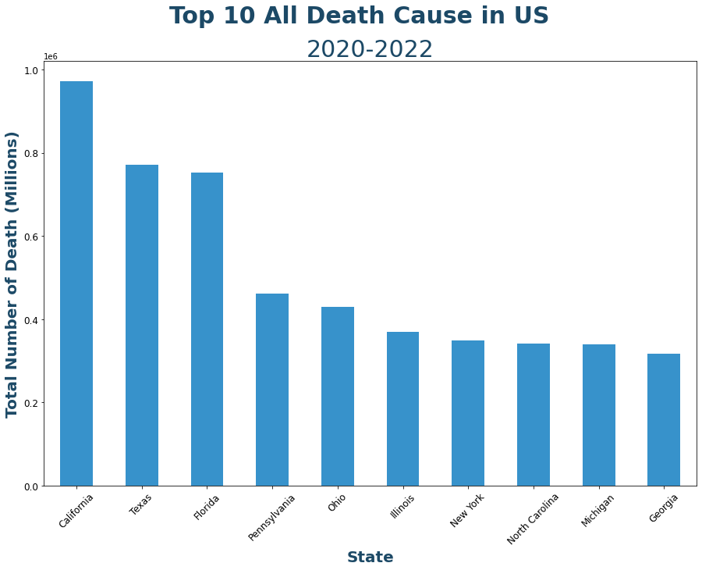
What are the top 10 states with the highest number of deaths?

Slide 7
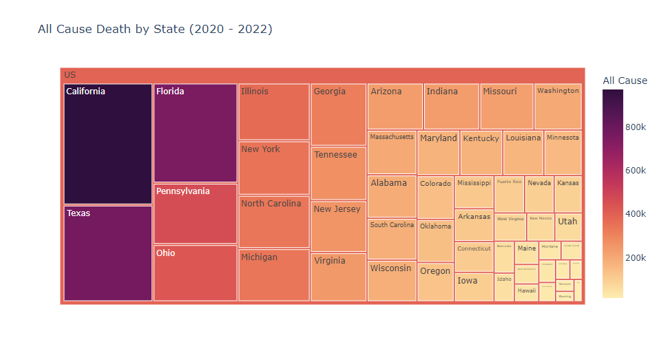
The states with the highest number of deaths in the United States are California, Texas, Florida, Pennsylvania, Ohio, Illinois, New York, North Carolina, Michigan and Georgia. Through this chart you can clearly see the number drop as it goes from California to Georgia.

Slide 8
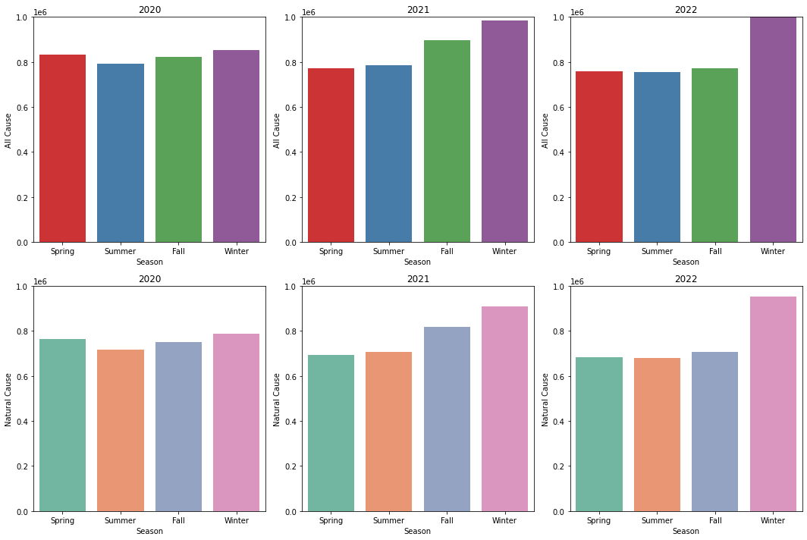
In what season do most deaths occur by natural causes and what is the correlation between the seasons where the most deaths occur by all causes and natural causes?

Slide 9
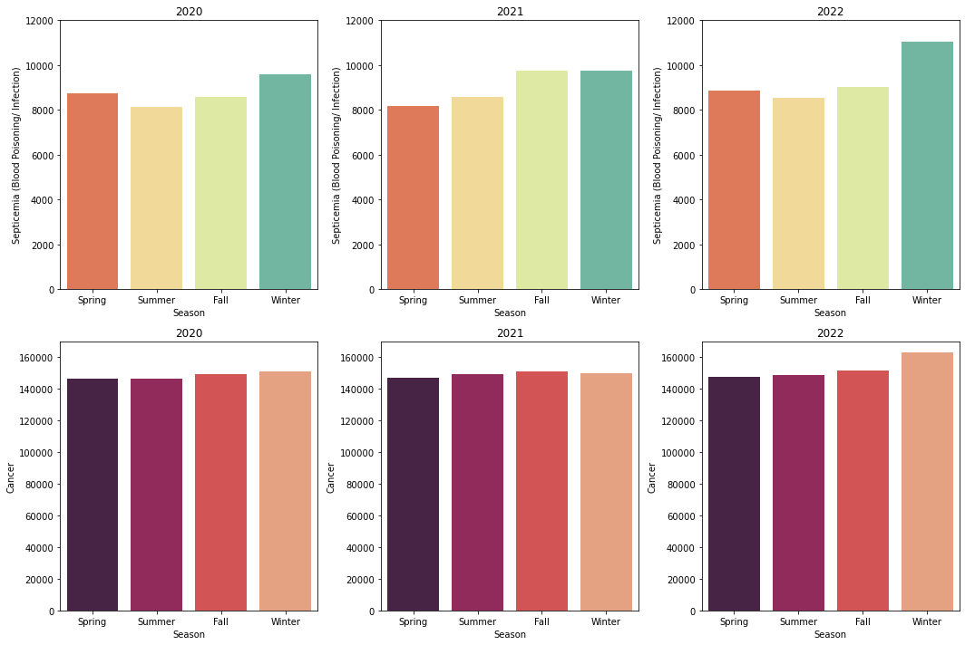
In what season is the death rate highest due to Cancer & Septicemia?

Slide 10
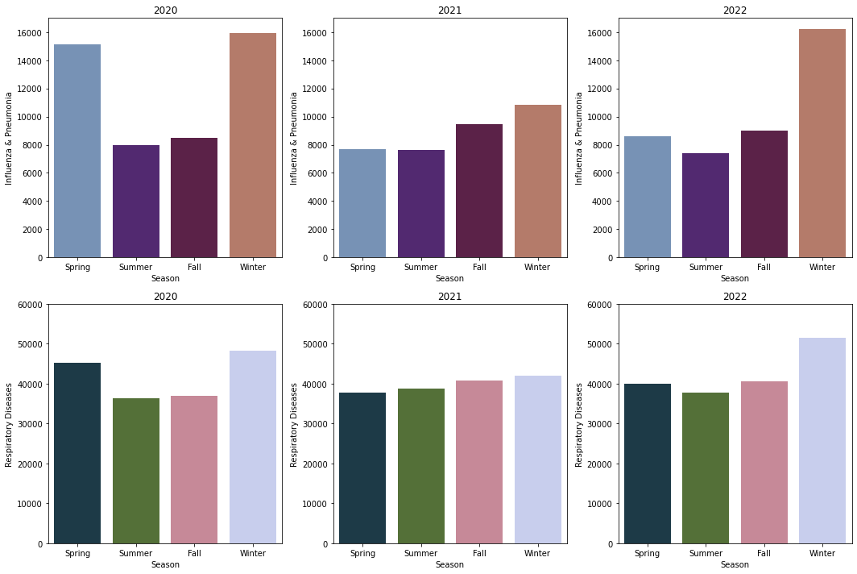
In what season is the death rate highest due to Influenza & Respiratory Diseases?

Slide 11
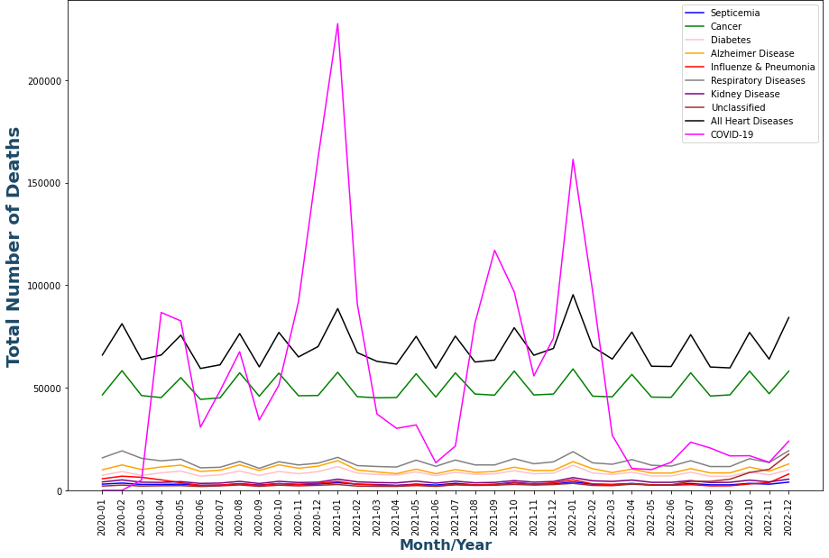
Does COVID-19 have any impact on the death rates versus other mortality measures?

Slide 12
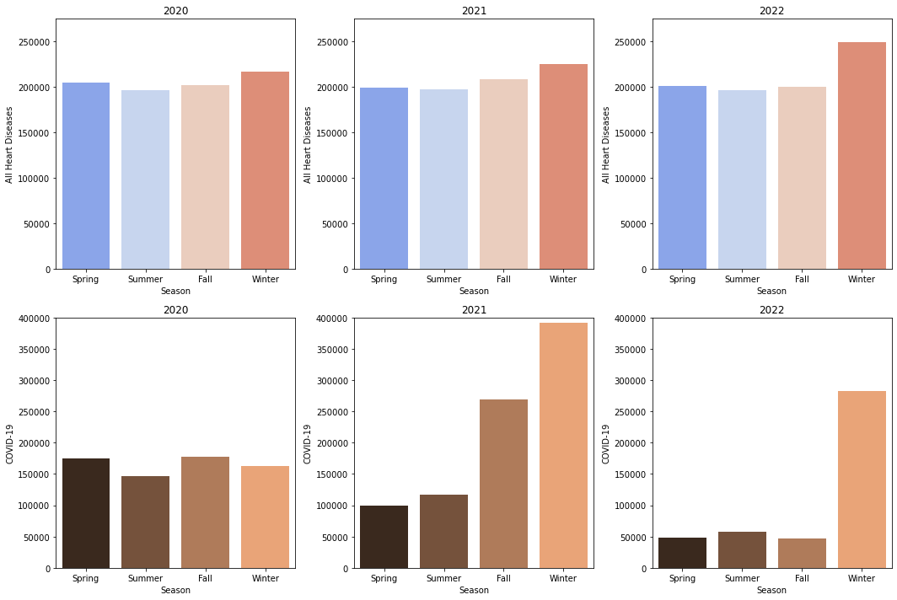
In what season is the death rate highest due to COVID 19 and heart disease?

Slide 13
Conclusion
Our project is an opportunity to look at the leading causes of death in the United States. The data we selected shows the number of deaths by states and their causes. This dataset and the visuals we provided are important because they show us the prevalence of certain diseases from the years 2020-2023. In the last couple of years health in America has been a crucial topic of conversation because of COVID-19. The coronavirus has made many Americans focus more on the importance of health and the causes of many diseases. In 2021 the highest number of deaths occurred in the United States, this is because the fatality rates of covid were rising while there were still several people suffering from other illnesses such as cancer, diabetes, respiratory diseases, influenza and more. While covid emerged and affected over 100 million Americans, the leading cause of death before covid was heart disease. Our project is essential because knowing the leading causes of death in America as well as the numbers of deaths will cause more people to engage in healthy habits and take all the right preventative measures so that they can increase their chances of not getting sick.

